Slide 1
Java IO and Thread
指導教授：蕭宏章
學生：蔡嘉平
分散式計算實驗室

Slide 2
大綱
學習目標
您可能會用到的工具
作業

Slide 3
學習目標
學習目標
簡介
Demo
您可能會用到的工具
作業

Slide 4
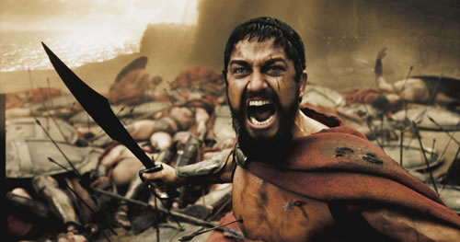
簡介
給我更難的作業!!!!

Slide 5

Demo
你/妳的程式
Custom Search Request (URL)
取得Google搜尋結果
Search Results in JSON
下載圖片(Multithreading )
下載任意URL資源都可能阻塞， 所以使用多執行緒並行下載資源
Java Class
Network
I/O
Thread
將圖片存入硬碟
(I/O)

Slide 6
您可能會用到的工具
學習目標
您可能會用到的工具
Google Custom Search
Java Class
作業

Slide 7
Google Custom Search Request Format
Example
https://www.googleapis.com/customsearch/v1?key={your key}&cx={your Search id}&searchType=image&imgSize=huge&fileType=jpg&alt=json&q=qry
Key
Search ID
Search type
Image Size
File Type
alt=json 以json格式回傳
q=qry qry為你所要搜尋的內容為何?直接輸入即可
每次查詢最多回傳10個結果，一天只能查詢100次。

Slide 8

Google Custom Search API (1/6)
Google APIs console

Slide 9
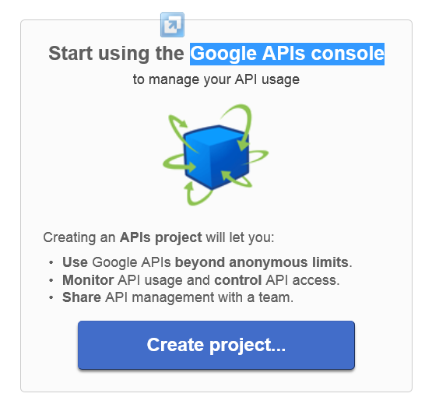
Google Custom Search API (2/6)
Google APIs console

Slide 10
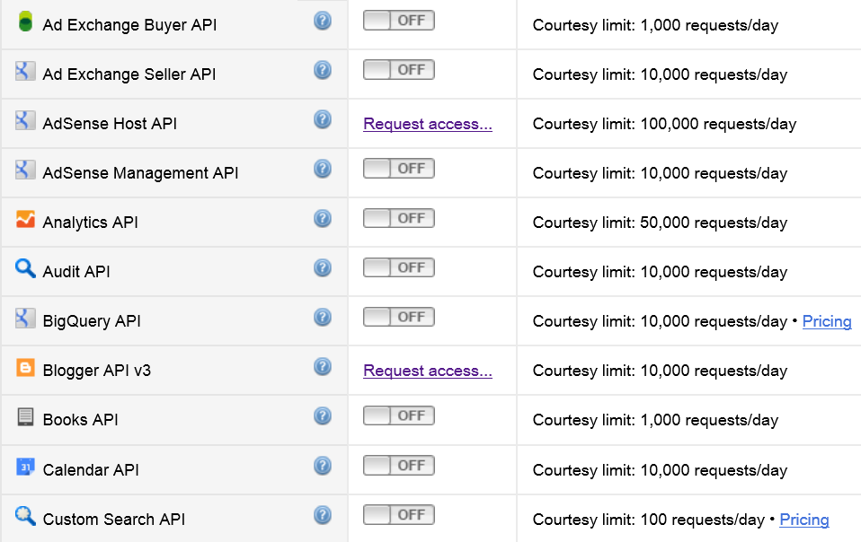
Google Custom Search API (3/6)
Google APIs console

Slide 11
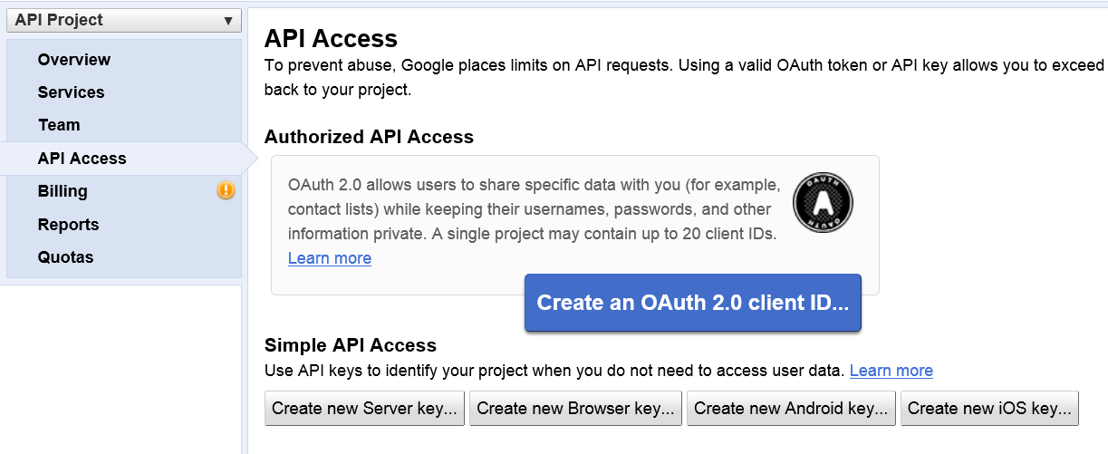
Google Custom Search API (4/6)
Google APIs console

Slide 12
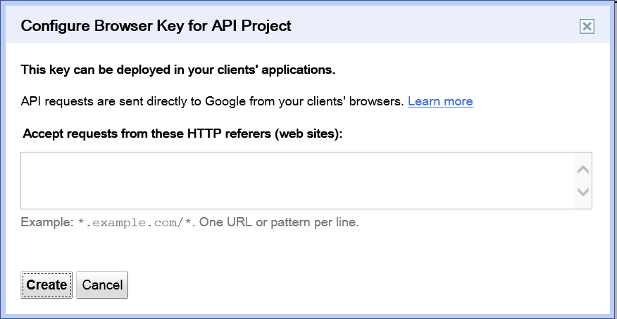
Google Custom Search API (5/6)
Google APIs console

Slide 13
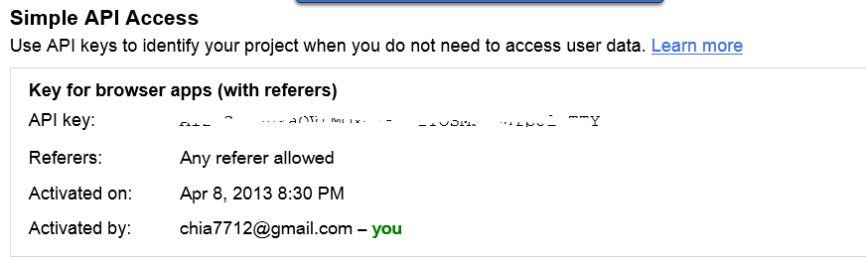
Google Custom Search API (6/6)
Google APIs console

Slide 14

Google Custom Search Google 自訂搜尋 (1/3)
Google 自訂搜尋

Slide 15
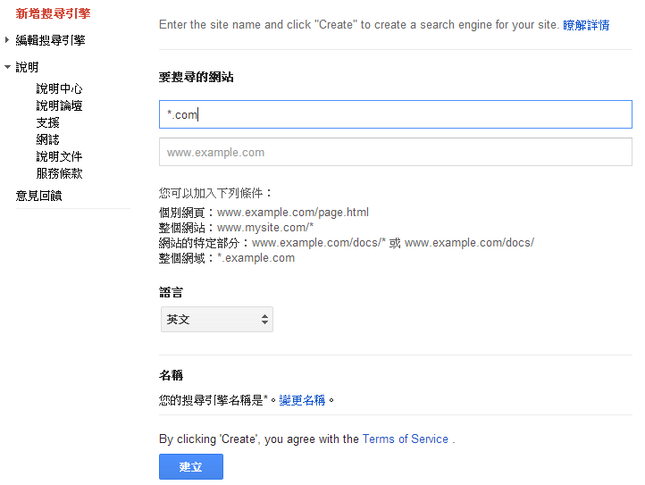
Google Custom Search Google 自訂搜尋 (2/3)
Google 自訂搜尋 (http://www.google.com/cse/ 右上角建立自訂搜尋引擎)

Slide 16
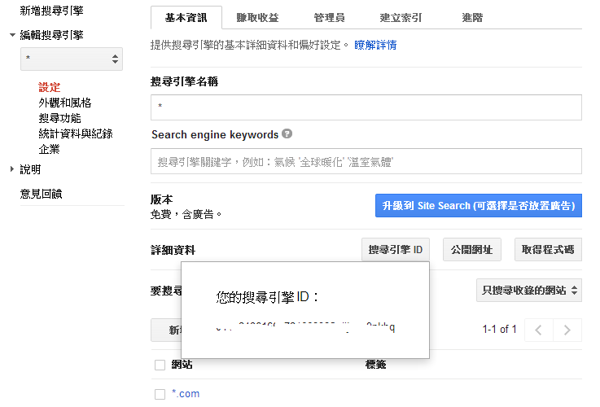
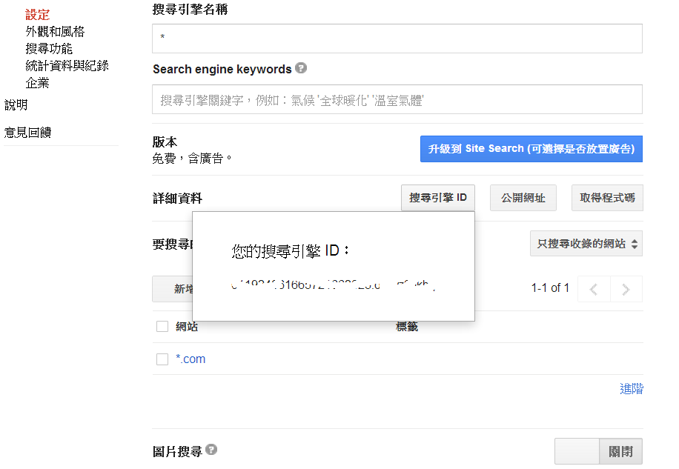
Google Custom Search Google 自訂搜尋 (3/3)
Google 自訂搜尋

Slide 17
Java Class 概觀
Network
URL
I/O
InputStreamReader
ByteArrayOutputStream
Thread
Runnable
Executor
Executors

Slide 18
Java Class java.net.URL
Introduction
Class URL represents a Uniform Resource Locator, a pointer to a "resource" on the World Wide Web
Constructor
URL(String spec)
Creates a URL object from the String representation
Method
InputStream openStream()
Opens a connection to this URL and returns an InputStream for reading from that connection

Slide 19


Java Class 在開始Java I/O之前…
Network
File Console
你的程式
byte
char
String
InputStream
InputStreamReader FileReader
BufferedReader
Java
免除你/妳額外處理byte的程式碼
1000000000000000 個人都說讚

Slide 20
Java Class java.io.InputStreamReader
Introduction
An InputStreamReader is a bridge from byte streams to character streams
Constructor
InputStreamReader (InputStream in)
Creates an InputStreamReader that uses the default charset
Method
int read (char[] cbuf, int offset, int length)
Reads characters into a portion of an array

Slide 21
Java Class java.io.ByteArrayOutputStream
Introduction
This class implements an output stream in which the data is written into a byte array
Constructor
ByteArrayOutputStream ()
Creates a new byte array output stream
Method
void write (byte[] b, int off, int length)
Writes length bytes from the specified byte array starting at offset off to this byte array output stream

Slide 22
Java Class Interface Runnable
Introduction
The Runnable interface should be implemented by any class whose instances are intended to be executed by a thread. The class must define a method of no arguments called run
Method
void run ()
When an object implementing interface Runnable is used to create a thread, starting the thread causes the object's run method to be called in that separately executing thread

Slide 23
Java Class Interface Executor
Introduction
An object that executes submitted Runnable tasks
Method
void execute (Runnable command)
Executes the given command at some time in the future

Slide 24
Java Class java.util.concurrent.Executors
Introduction
Factory and utility methods for Executor, ExecutorService, ScheduledExecutorService, ThreadFactory, and Callable classes defined in this package
Method
static ExecutorService newCachedThreadPool ()
Creates a thread pool that creates new threads as needed, but will reuse previously constructed threads when they are available
static ExecutorService newFixedThreadPool(int nThreads)
Creates a thread pool that reuses a fixed number of threads operating off a shared unbounded queue

Slide 25
作業
學習目標
您可能會用到的工具
作業
成績計算
繳交方式

Slide 26
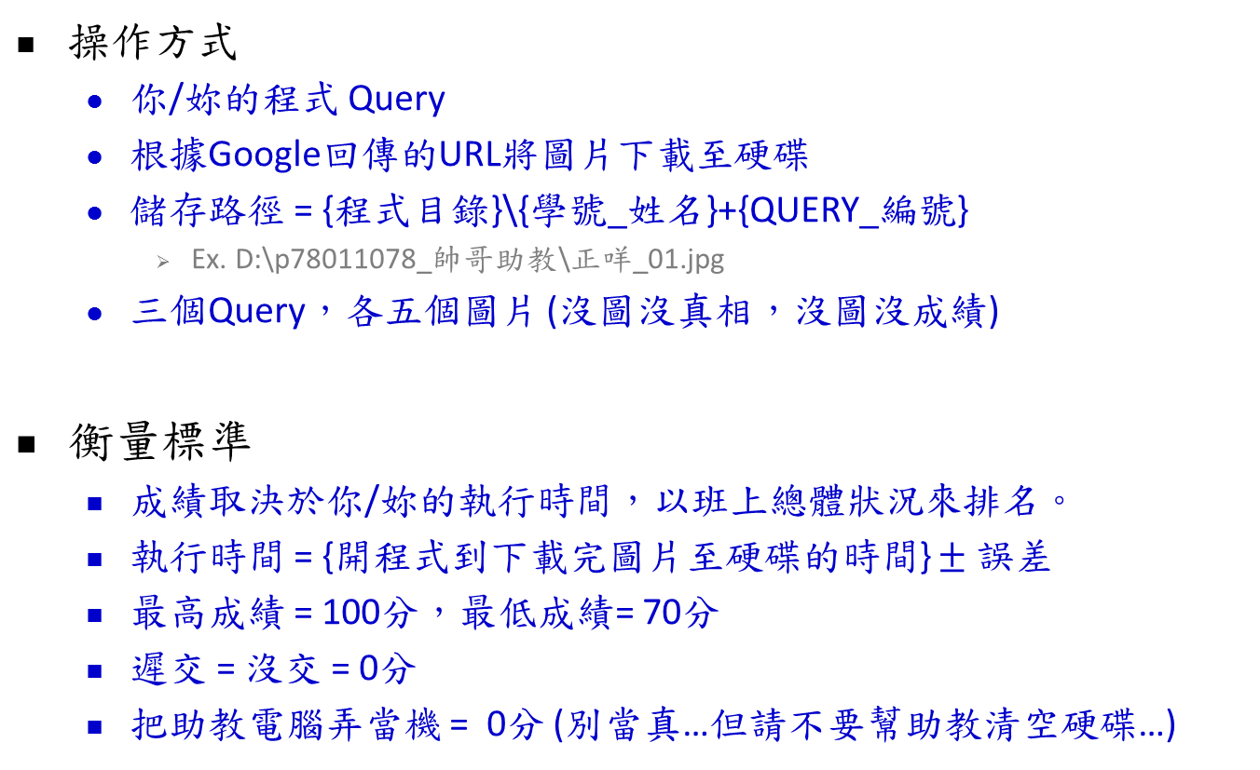
成績計算
操作方式
你/妳的程式 Query
根據Google回傳的URL將圖片下載至硬碟
儲存路徑 = {程式目錄}\{學號_姓名}+{QUERY_編號}
Ex. D:\p78011078_帥哥助教\正咩_01.jpg
三個Query，各五個圖片 (沒圖沒真相，沒圖沒成績)
衡量標準
成績取決於你/妳的執行時間，以班上總體狀況來排名。
執行時間 = {開程式到下載完圖片至硬碟的時間} $±$ 誤差
最高成績 = 100分，最低成績= 70分
遲交 = 沒交 = 0分
把助教電腦弄當機 = 0分 (別當真…但請不要幫助教清空硬碟…)

Slide 27
繳交方式
檔名
學號_姓名_HW2
Ex. p78011078_帥哥助教_HW2
檔案格式
Jar
上傳至Moodle
Homework 2 - Java IO and Thread
期限
下次上課前 (4/16的午夜之前)

Slide 28
Thank You!!!

